Slide 1

Project Success Metrics
Learn how to measure project success using key performance indicators (KPIs), identify lessons learned, and areas for improvement.

Slide 2
Key Performance Indicators (KPIs)
1
Time Management
2
Budget Control
3
Customer Satisfaction
On-time delivery: Ensure projects are completed within established deadlines to meet client expectations.
Cost variance: Monitor and control project costs to prevent overspending and maximize profitability.
Net Promoter Score: Measure customer loyalty and satisfaction to identify areas of improvement and build long-term relationships.

Slide 3
Measurement of Project Success
Quality Assurance
Stakeholder Engagement
Adherence to Scope
Ensure that deliverables meet established quality standards through continuous monitoring and review processes.
Assess level of stakeholder engagement during the project lifecycle to determine successful collaboration and communication.
Evaluate extent of adherence to project scope to measure successful project management and avoid scope creep.

Slide 4

Lessons Learned and Areas for Improvement
1
Analysis
Conduct a thorough post-project analysis to identify key lessons learned and areas for improvement.
Documentation
2
Create a comprehensive knowledge base that captures project insights and best practices for future reference.
3
Continuous Improvement
Promote a culture of continuous improvement by integrating lessons learned into project management processes.

Slide 5

Effective Project Metrics
Clear Objectives
Data-driven Decisions
Regular Evaluation
Establish clear and measurable objectives that align with the overall project goals and facilitate effective tracking.
Make evidence-based decisions by utilizing reliable data gathered from project metrics and performance indicators.
Regularly evaluate project metrics and adjust strategies and plans to ensure project success and optimize performance.

Slide 6

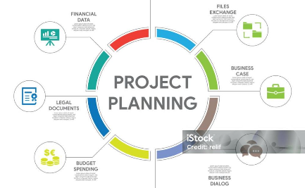
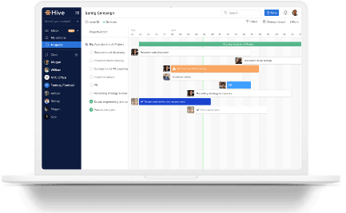
Ensuring Project Success
Strong Teamwork
Effective Planning
Utilize Project Management Tools
Encourage collaboration among team members to foster trust, enhance communication, and achieve project objectives.
Create structured project plans to outline tasks, milestones, and deliverables for efficient project execution.
Implement reliable project management tools to streamline processes and improve project coordination and control.

Slide 7
Key Takeaways
1
Measure Performance
2
Learn from Mistakes
3
Adaptability is Key
Embrace lessons learned to prevent future project pitfalls and enhance project success rates.
Cultivate an adaptive project culture that embraces change and adjusts strategies based on project metrics and feedback.
Use key performance indicators to assess project performance and drive continuous improvement.

Slide 8

Conclusion
By leveraging project success metrics, organizations can effectively monitor, evaluate, and improve project performance, leading to increased customer satisfaction and overall business success.

